Slide 1

Galleria!!!

Slide 2
Galleria!!!
PRESENTED BY:
Simra Asif !
Muhammad Furqan !
Muhammad Adiyan !

Slide 3
PROBLEM STATEMENT!
Galleria is certified company engaged in selling wide variety of paintings. They should also be categorize on a surface of painting. The user can get a better response from there!!!

Slide 4
Work Distribution !
Simra Asif | Muhammad Furqan | Muhammad Adiyan
Logo | Documentation | Image collection
Page theme
Design
All basic working on project
Word file
Finalization

Slide 5

Screenshots !
“Logo”

Slide 6
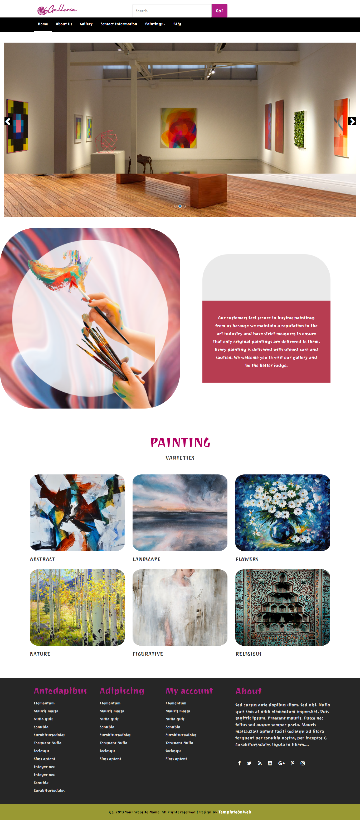
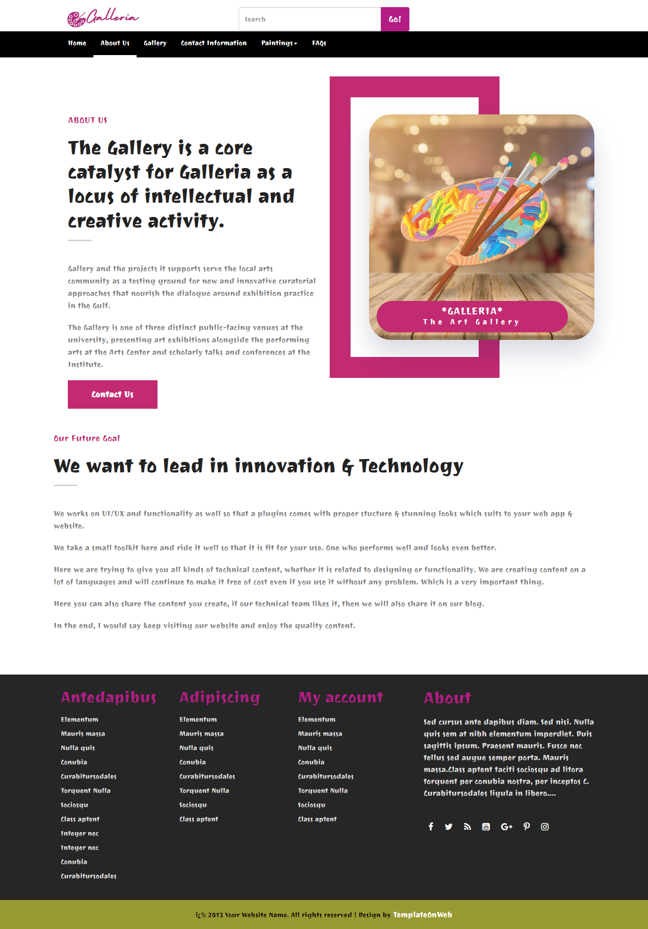
Home
About us

Slide 7
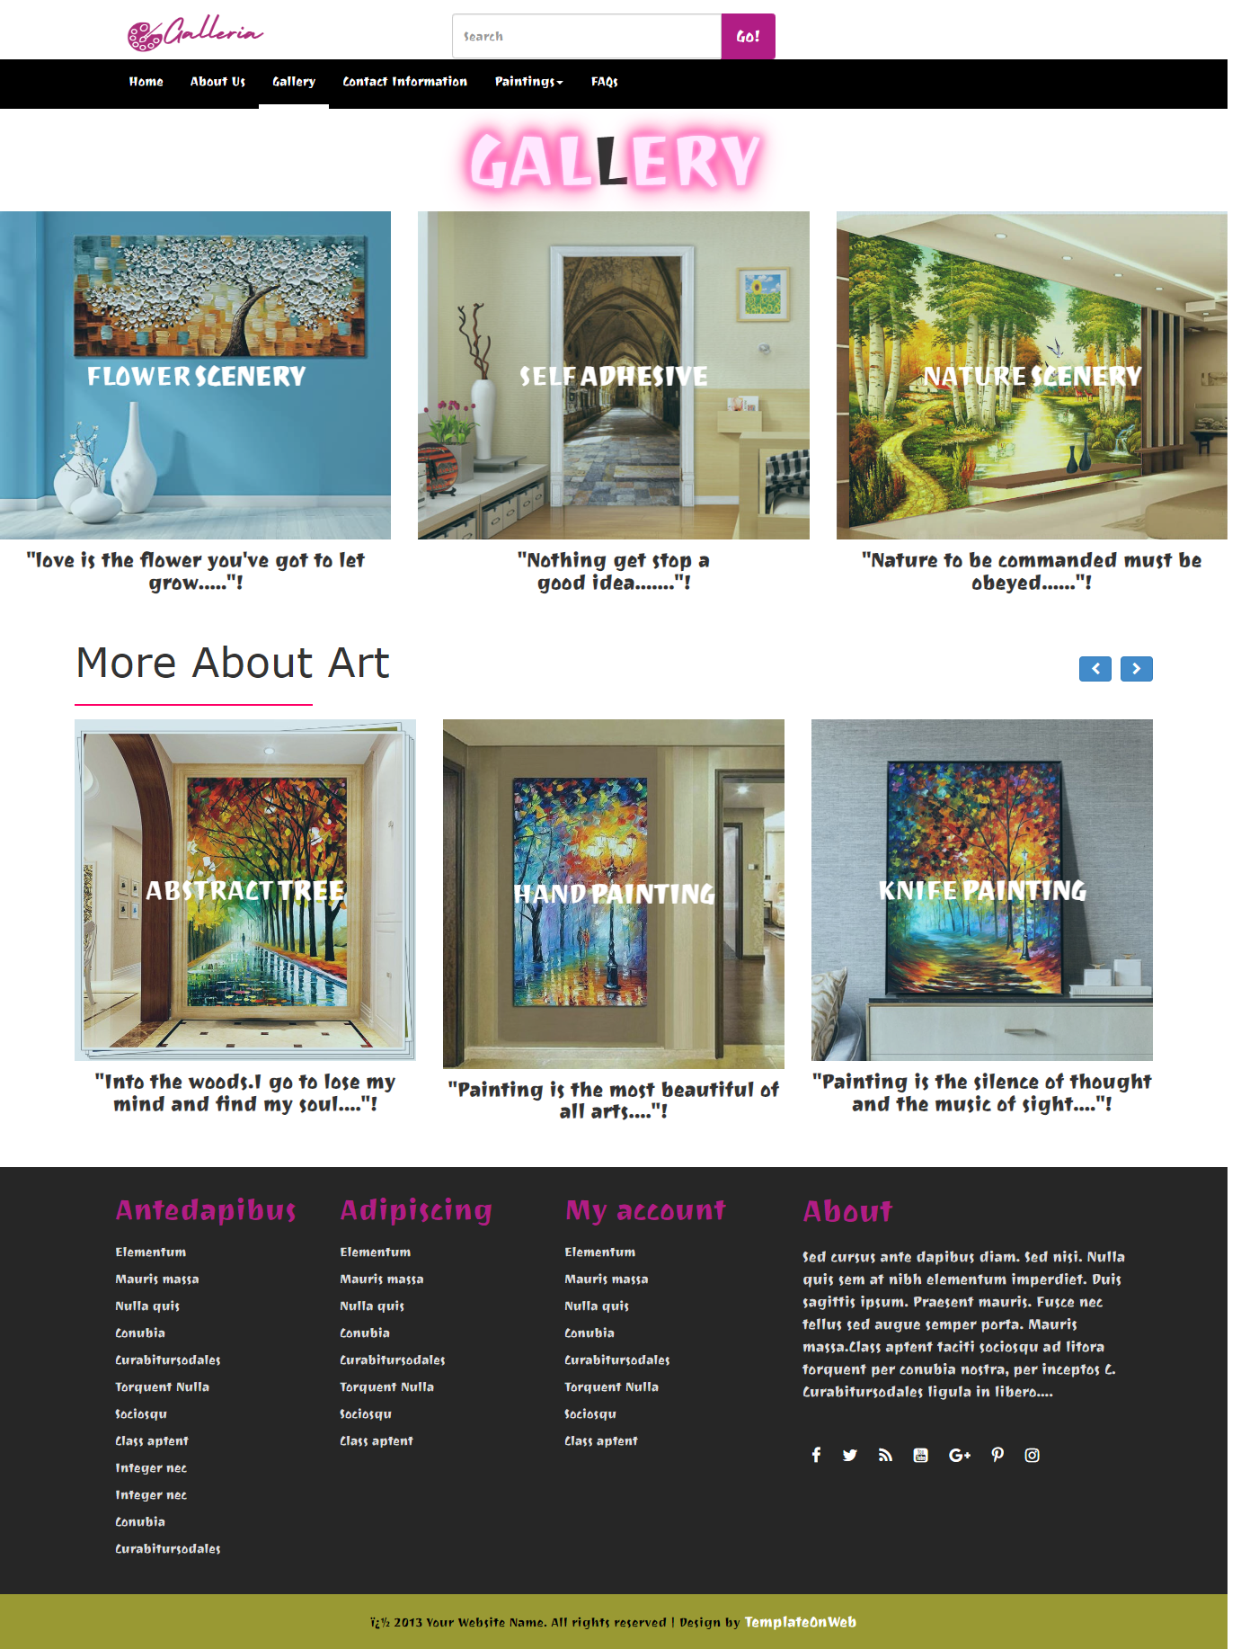
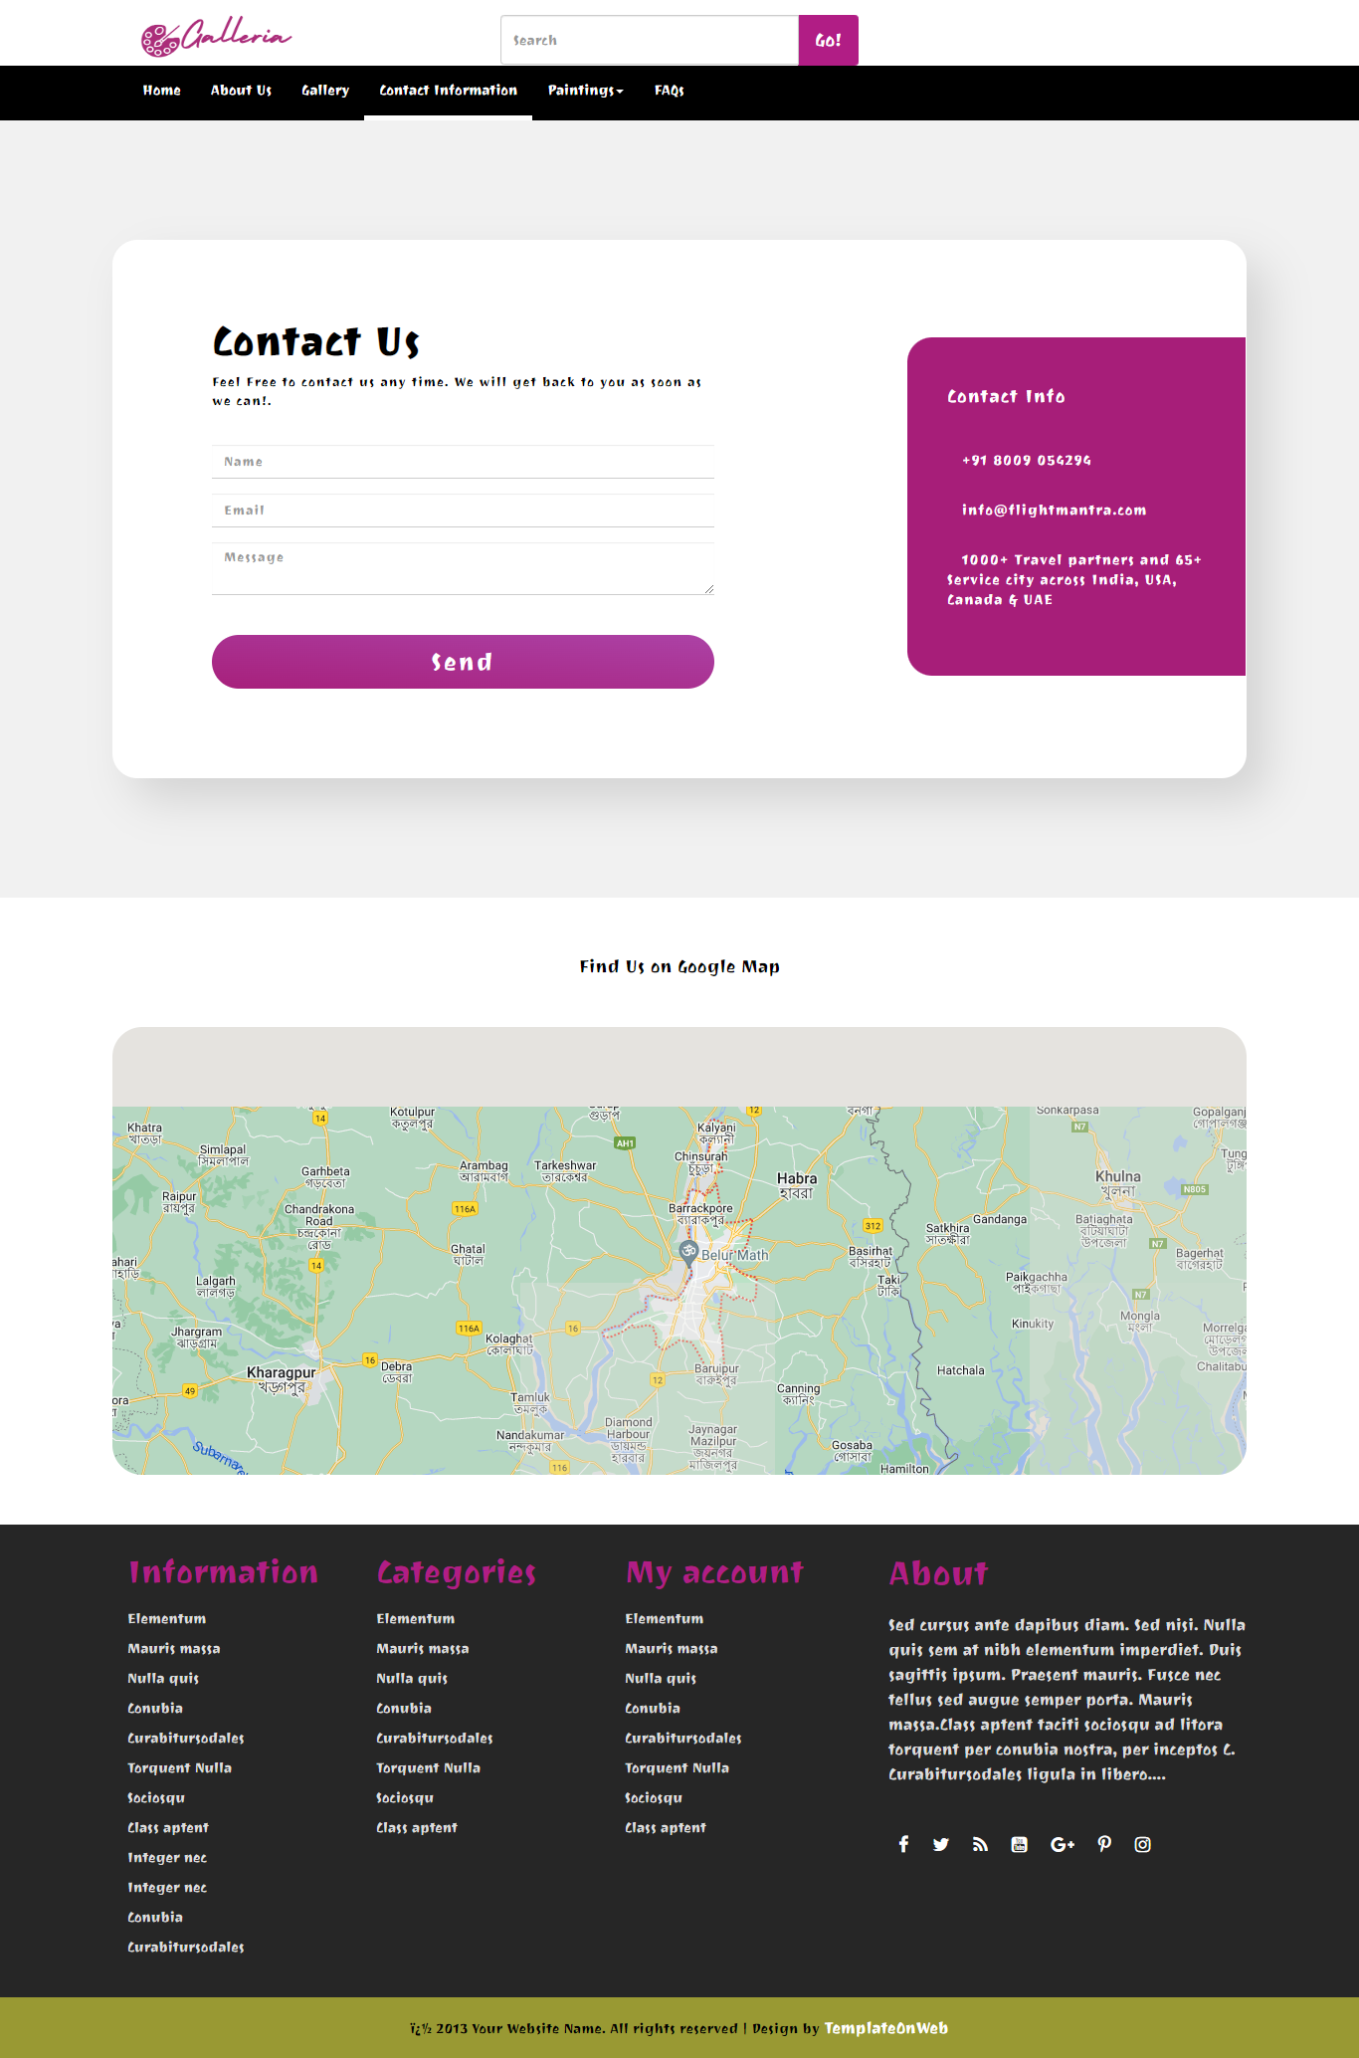
Gallery
Contact information

Slide 8
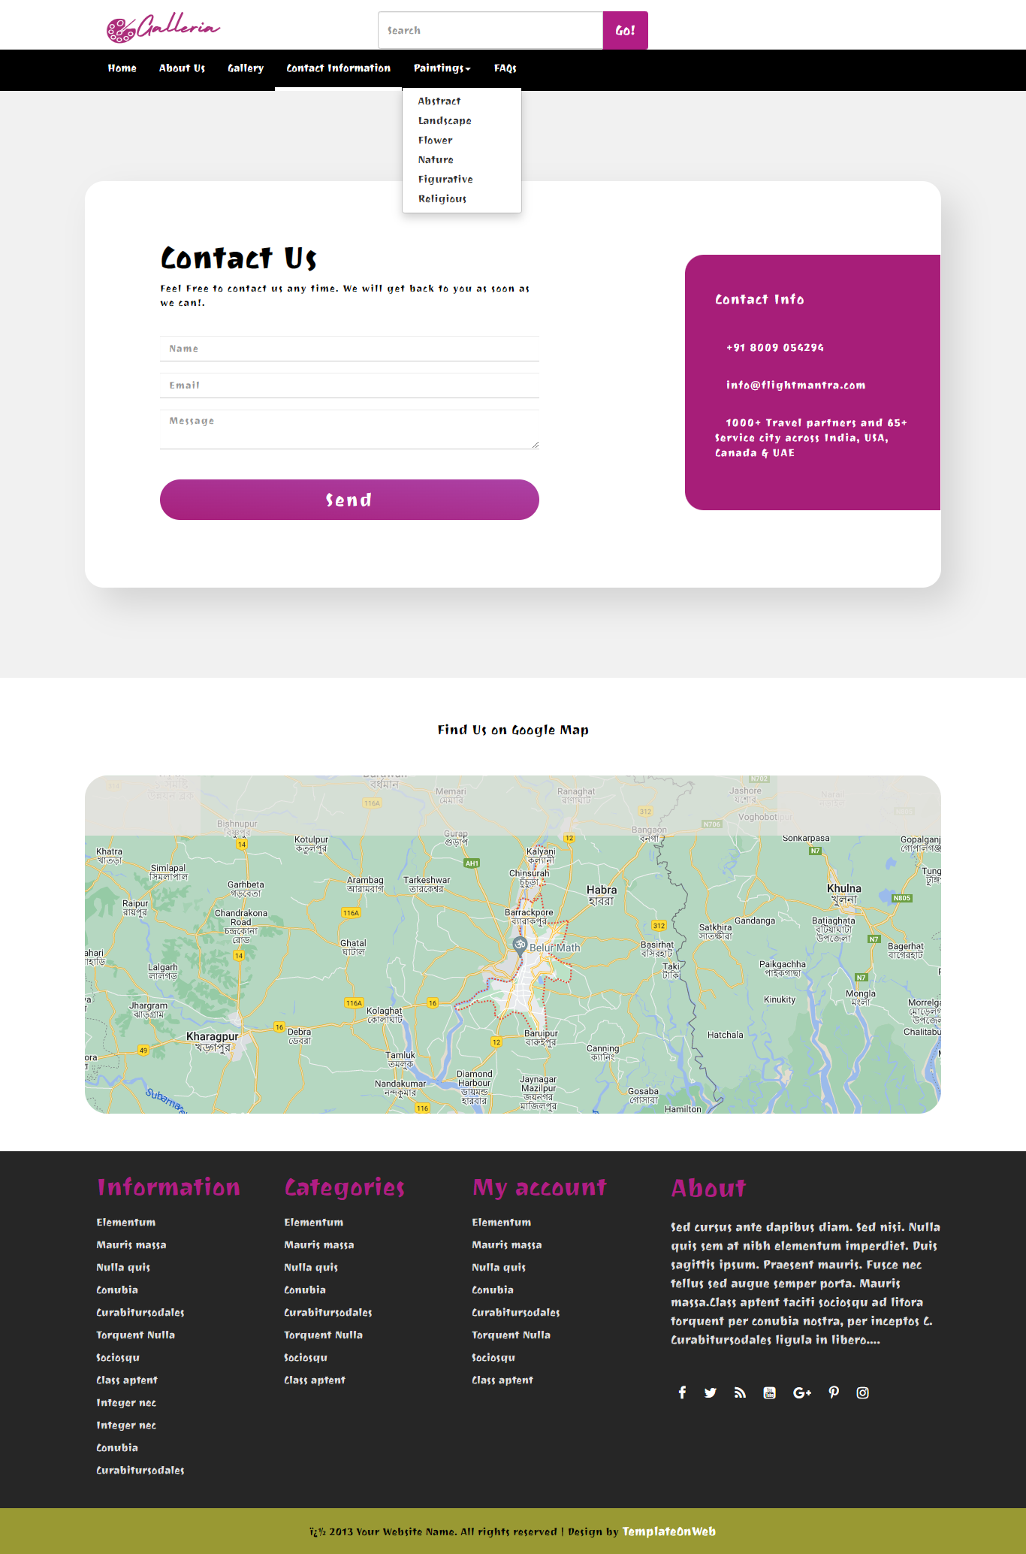
Categorization

Slide 9
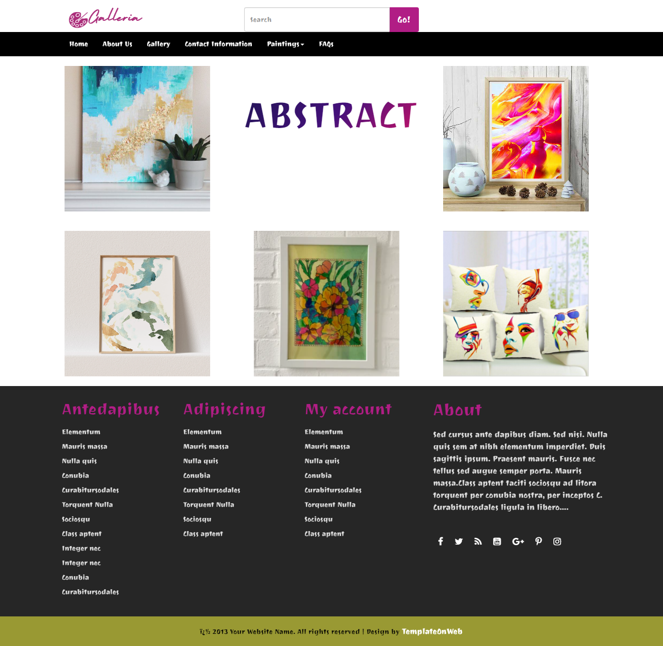
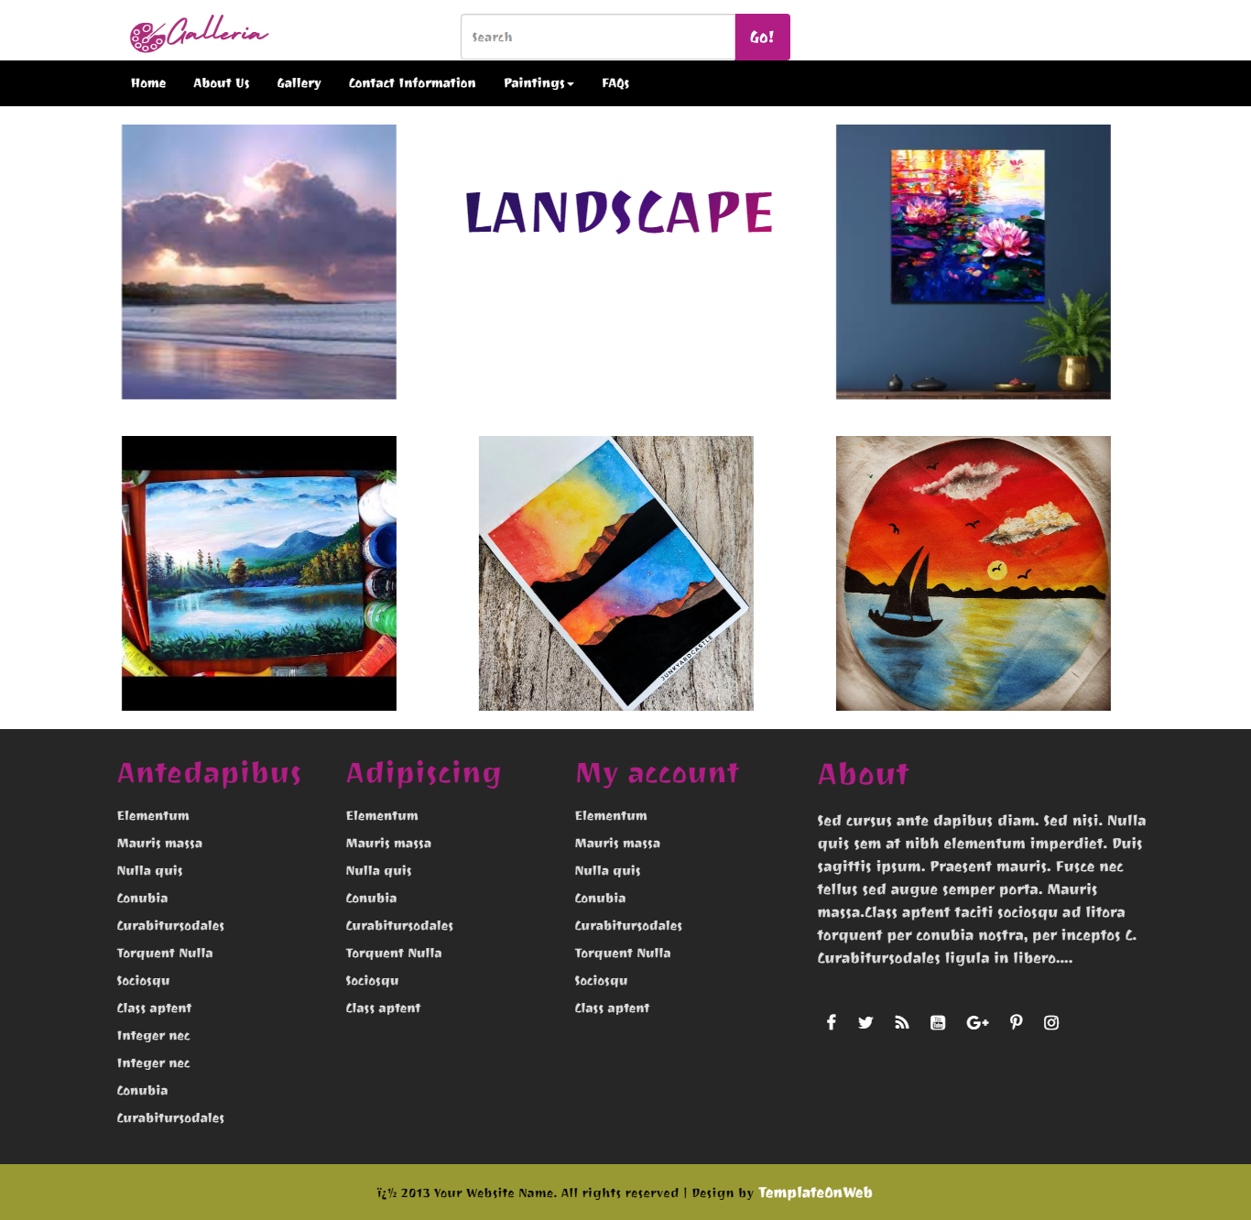
Abstract
Landscape

Slide 10
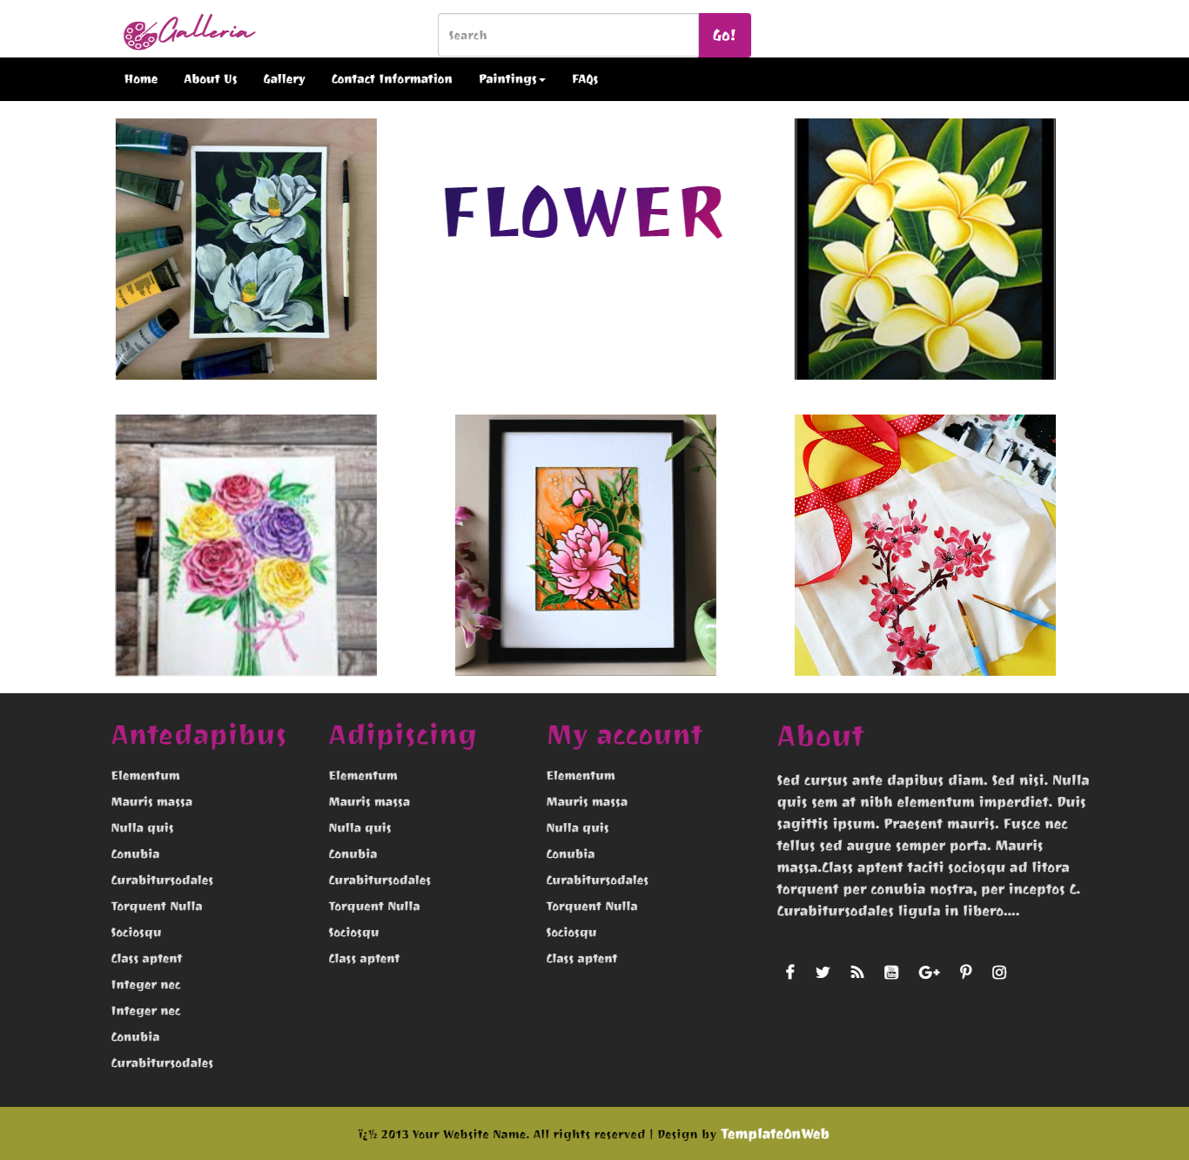
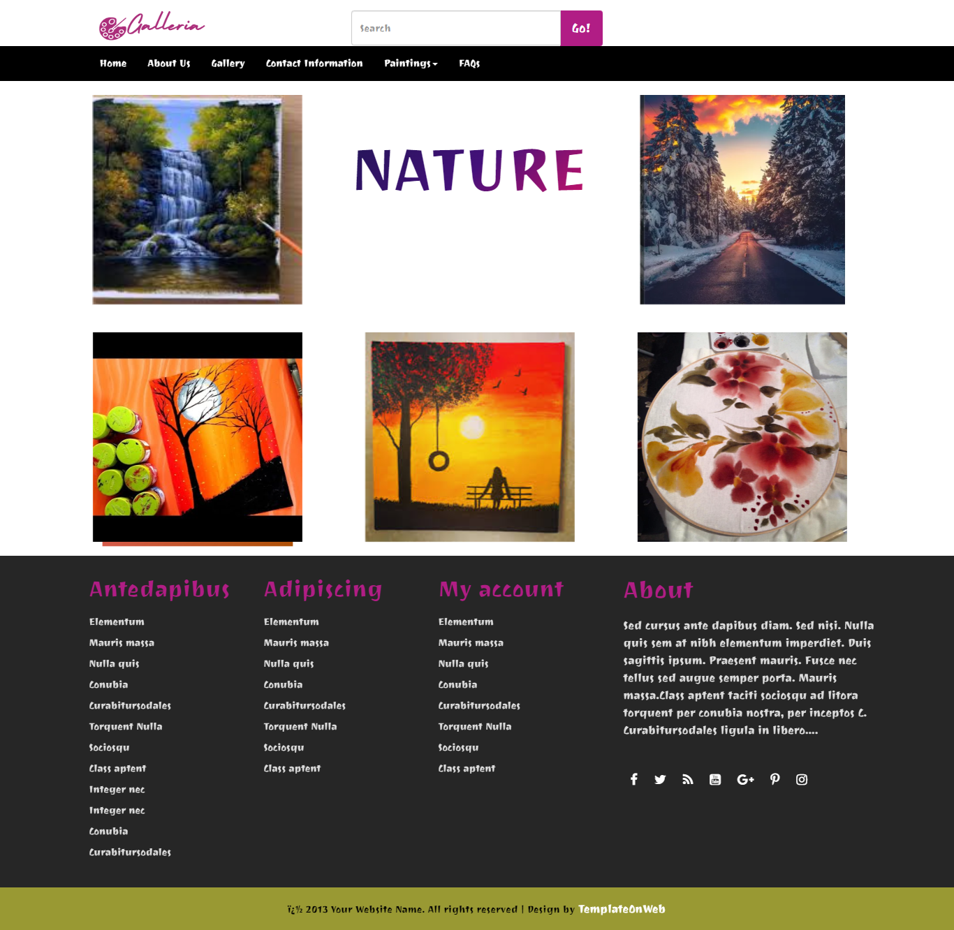
Flower
Nature

Slide 11
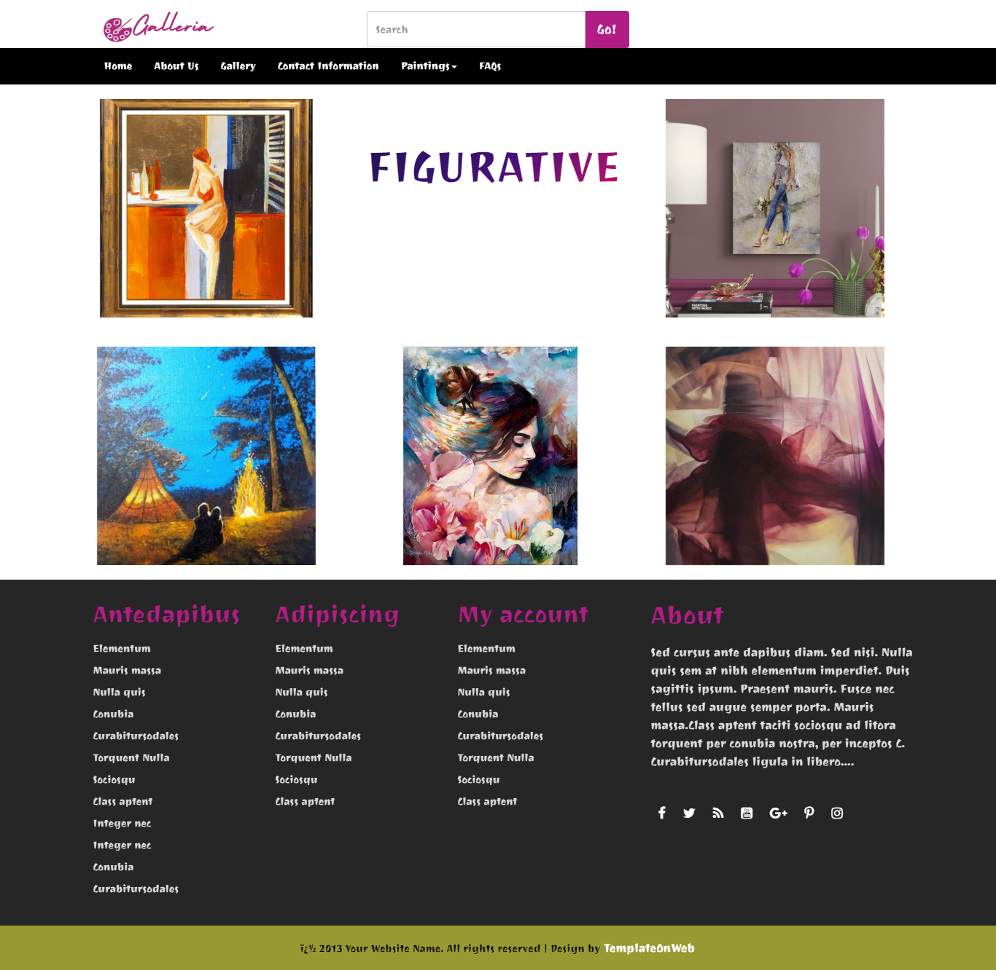

Figurative
Religious

Slide 12
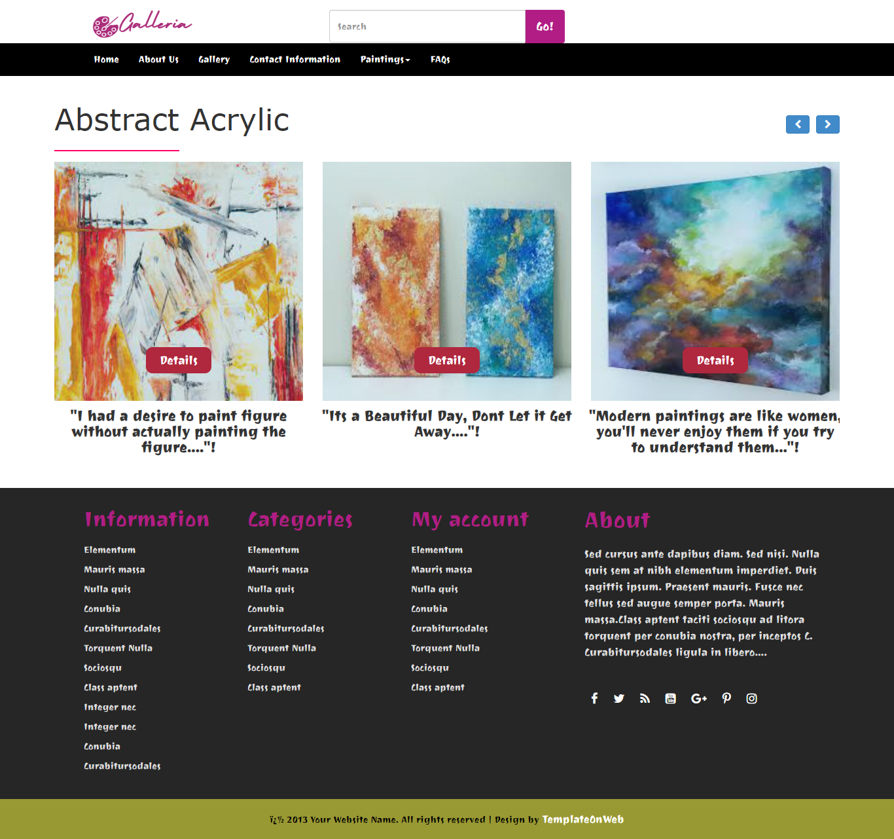

Surface categorization
Card Animation

Slide 13
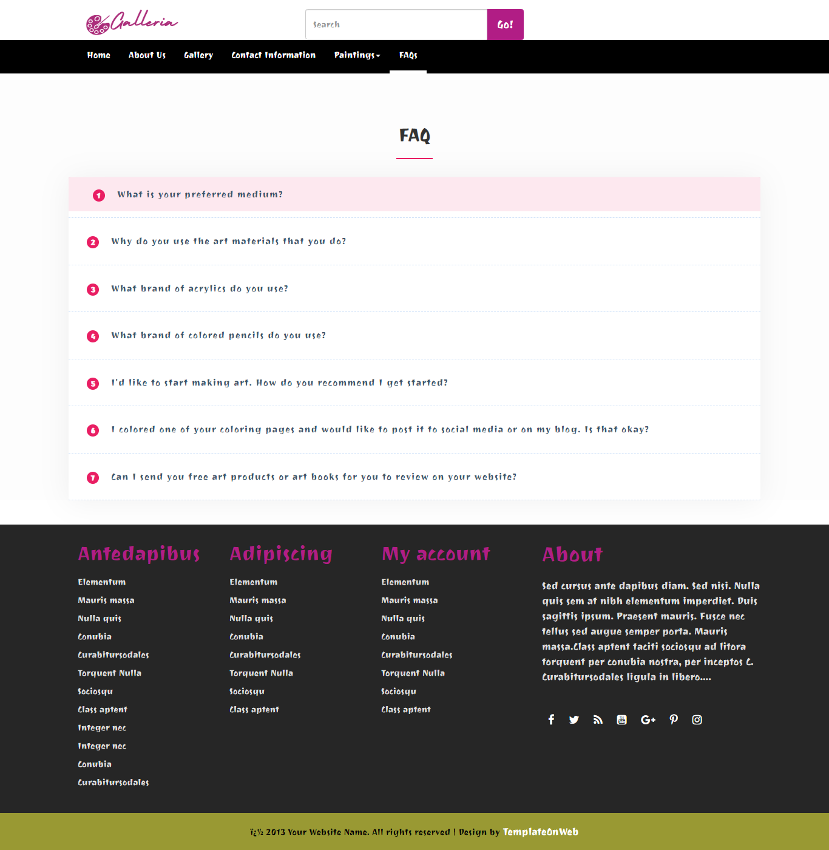
FAQ

Slide 14
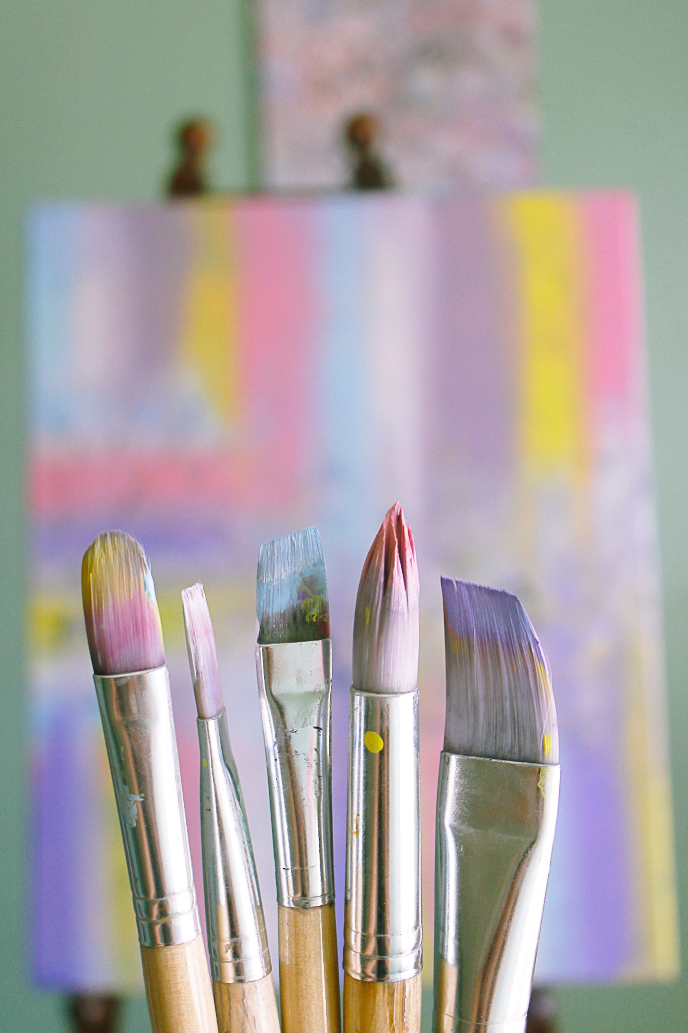
Thank you!

